Slide 1
Jack Dawdy Celebration of Life
August 2013

Slide 2
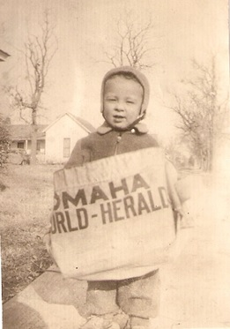
1944
Youngest Worker in Nebraska History

Slide 3
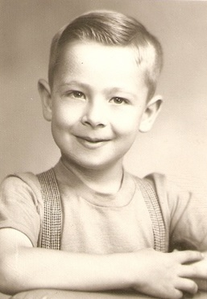
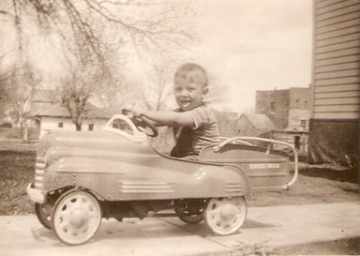
CHECK OUT THOSE WHEELS
MAMA’S LITTLE ANGEL

Slide 4
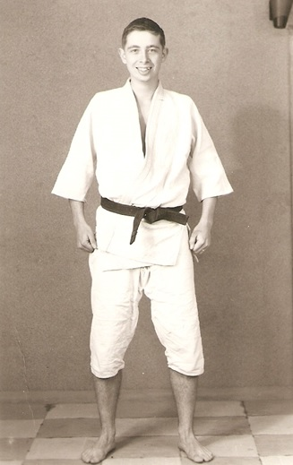
1960’s
DON’T MESS WITH THOSE MUSCLES

Slide 5
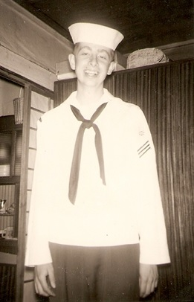
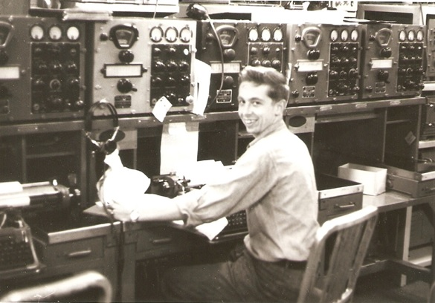
JAPAN IS NEVER THE SAME

Slide 6
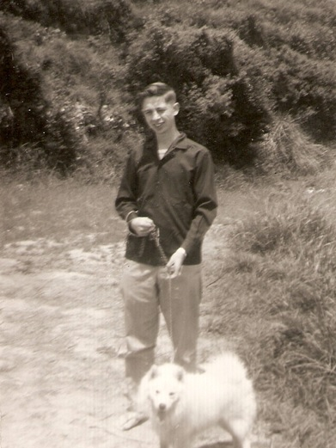
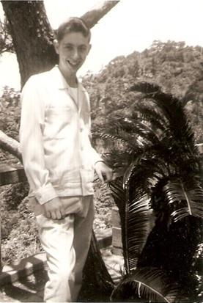
JACK’S FAVORITE JAPANESE GIRL
JAPANESE LEISURE TIME

Slide 7
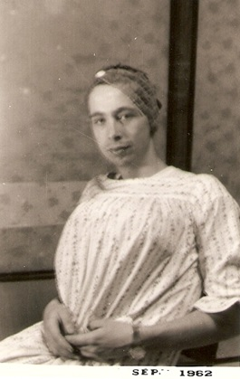
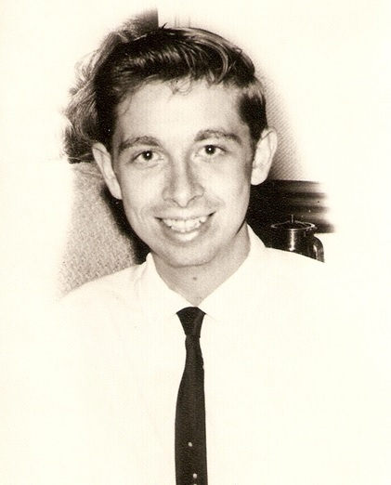
IMAGE FOR FAMOUS MOTION PICTURE

Slide 8
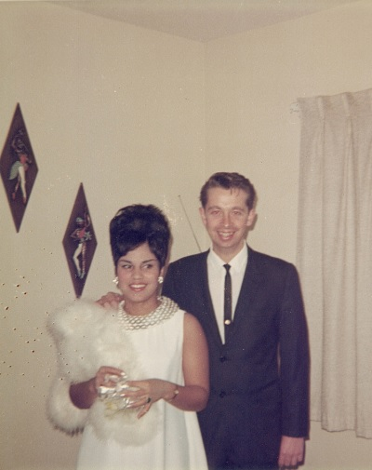
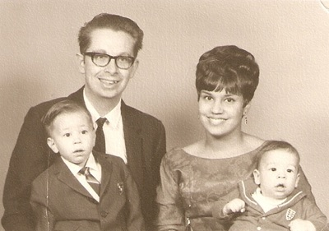
BABIES, BABIES, BABIES …OH MY
WHOSE TALLER? YVONNE OR HER HAIR

Slide 9
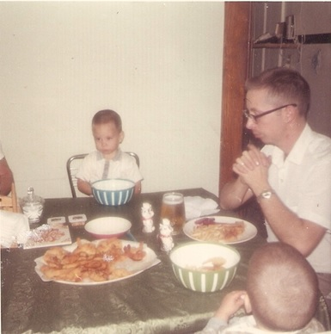
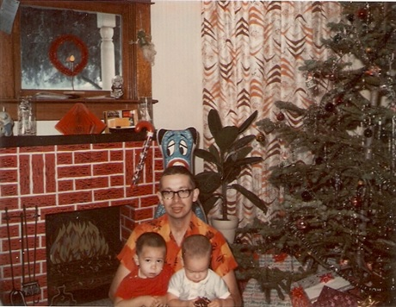

Slide 10
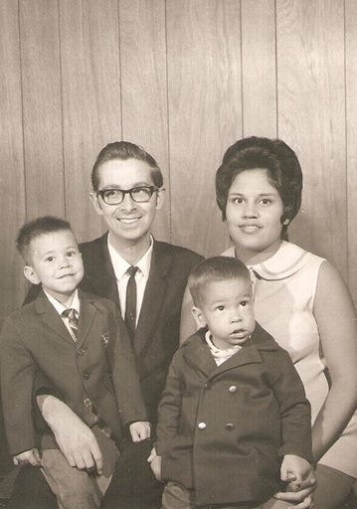
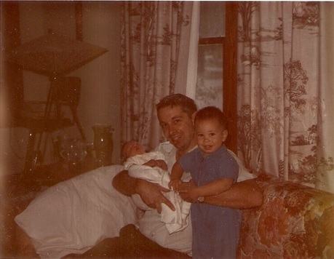
GROWING BOYS – TIRED PARENTS

Slide 11
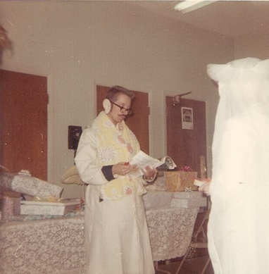
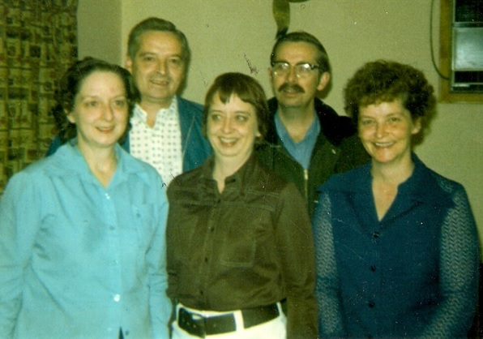
SIBLINGS THAT KNOW JACK’S SECRETS
PASTOR JACK
CHECK OUT THE EARPIECE

Slide 12
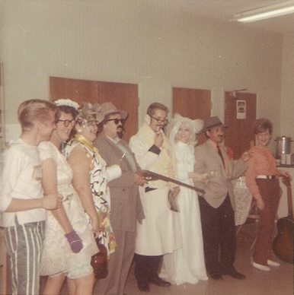
WOULD YOU TRUST THIS MAN TO MARRY YOU?

Slide 13
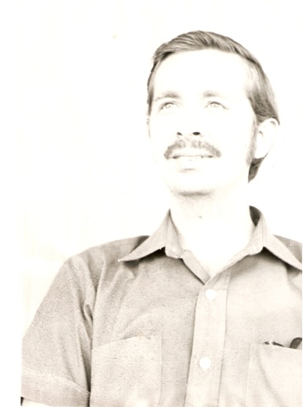
1970’S
CONTEMPLATING THE UNIVERSE

Slide 14
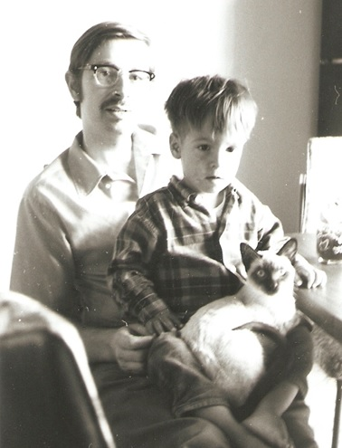
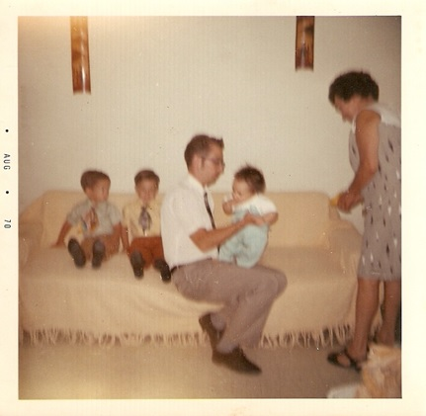
NEWEST DAWDY
BOY! DAVID GREW QUICK

Slide 15
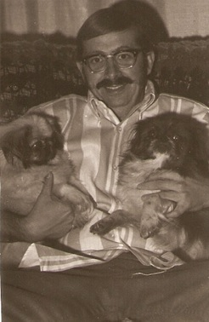
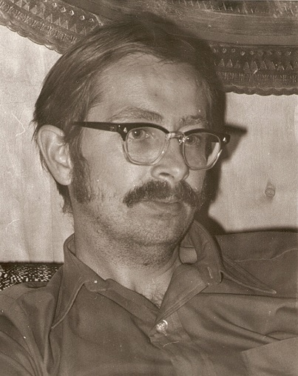
Hmm I WONDER WHAT HE’S THINKING
PETS SEEM TO LIKE JACK

Slide 16
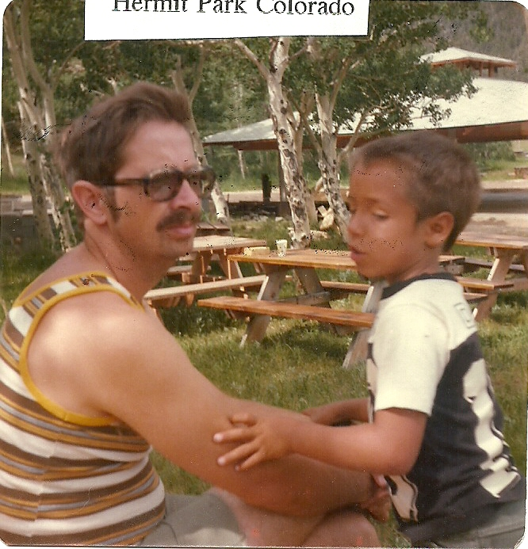
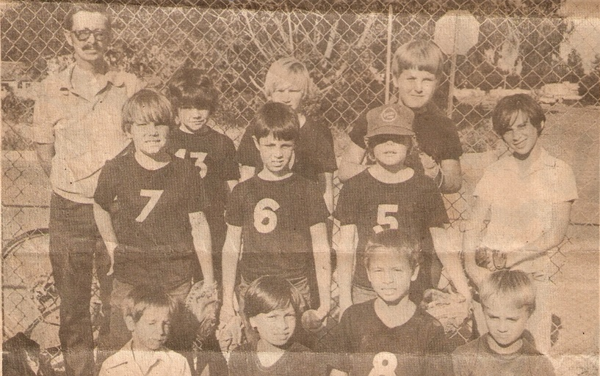
BERTHOUD WILL LET ANYONE COACH
DAD, HANG ON TO ME

Slide 17
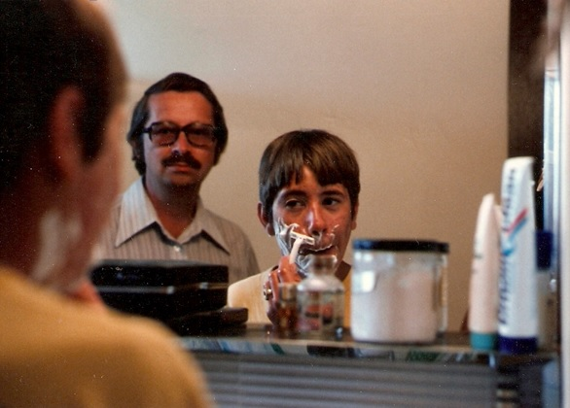
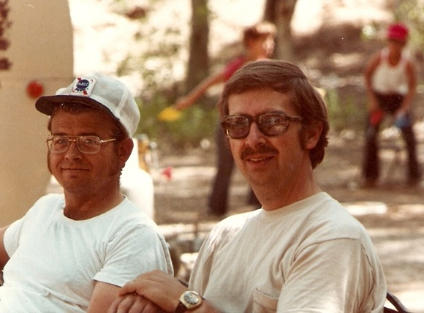
DON’T KNOW IF I TRUST THIS KID WITH A RAZOR
BEST BUDS

Slide 18
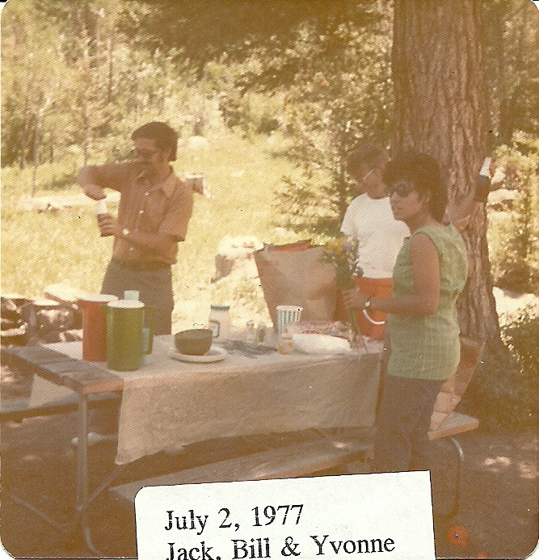
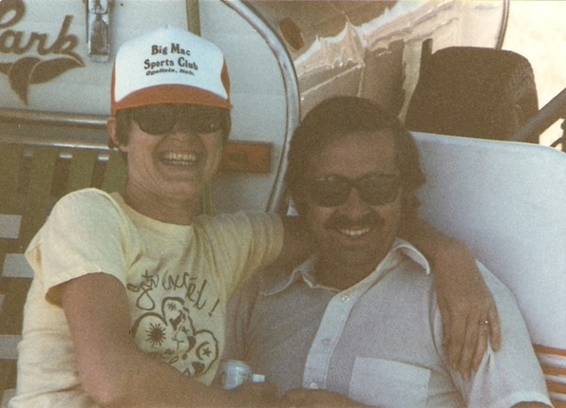
CAMPING FUN
LET’S CELEBRATE THE 4TH

Slide 19
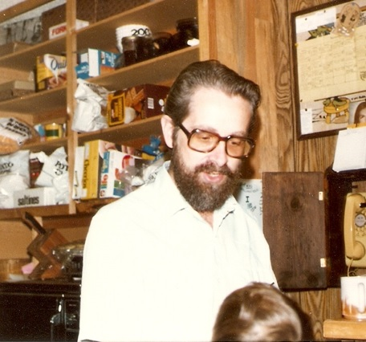
WOULD YOU BUY A USED CAR FROM THIS MAN?

Slide 20
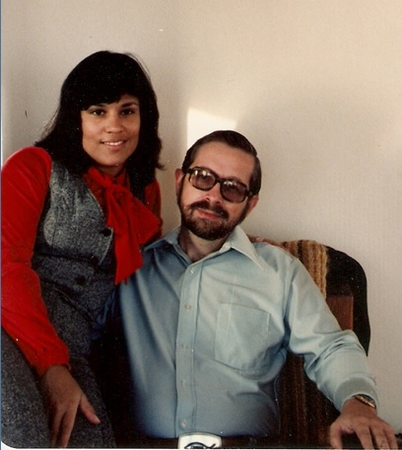
1980’s
WHERE’S THE CHRISTMAS TREE?

Slide 21
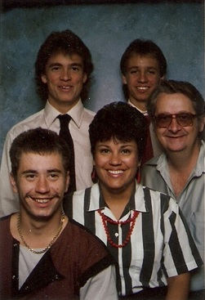
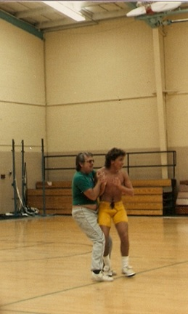
MIKE, DAVID, DENNIS, YVONNE, JACK
C’MON DAD; I CAN TAKE YOU

Slide 22
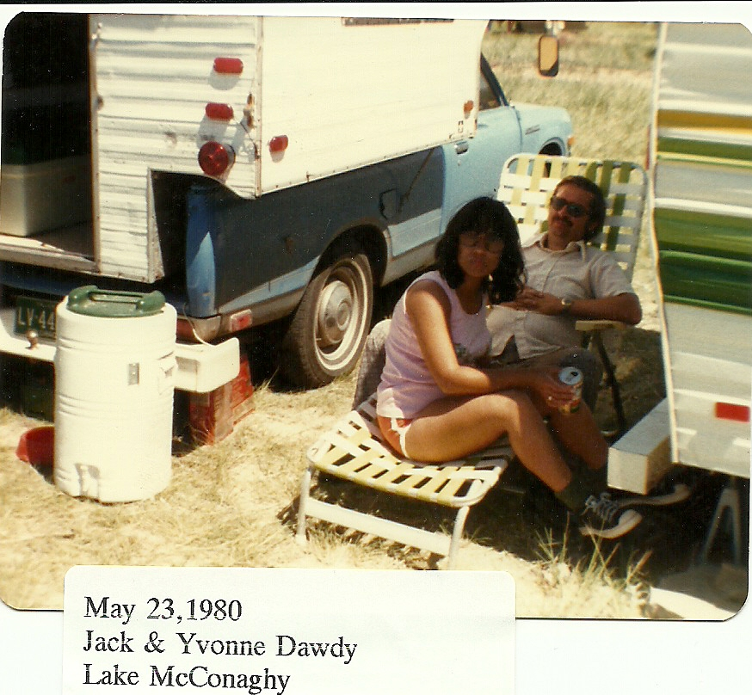
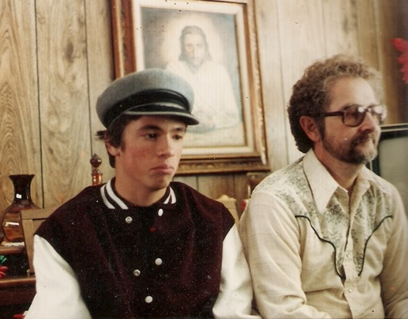
ARE WE HAVING FUN YET??
HOME AWAY FROM HOME

Slide 23
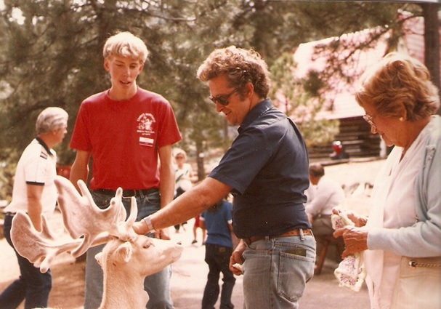
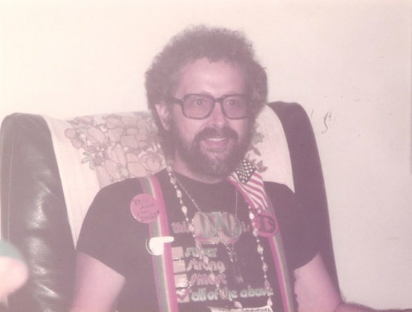
WHEN DID JACK GET CURLY HAIR?
GODSPELL CAST MEMBER?

Slide 24
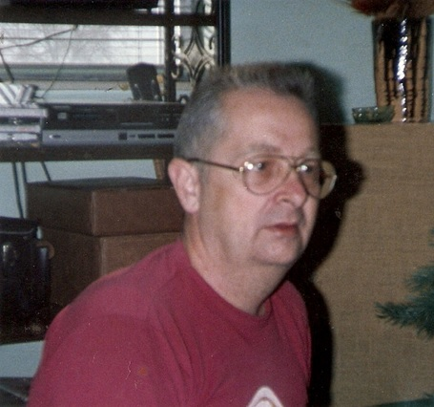
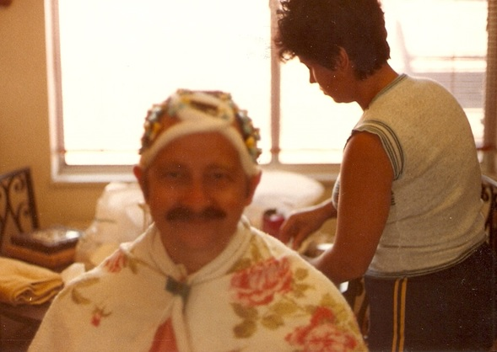
MYSTERY SOLVED ON THE HAIR
WHERE’S THE FACIAL HAIR?

Slide 25
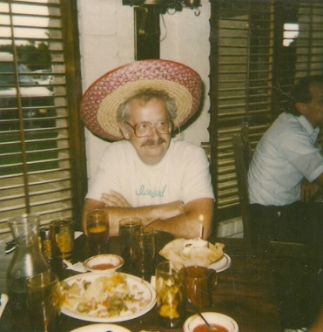
LET’S HAVE A PARTY
O’LE

Slide 26
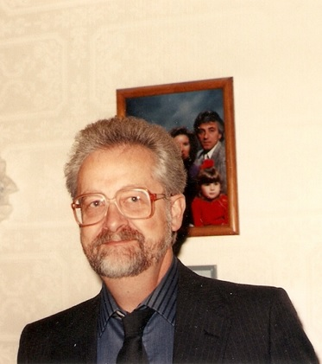
1990’s
HOW OLD AM I? I LOST TRACK

Slide 27
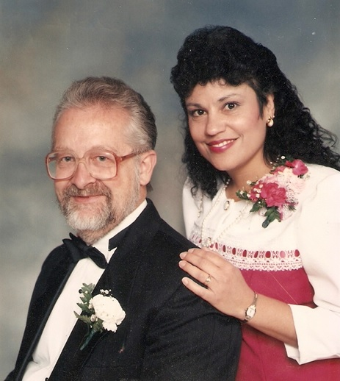
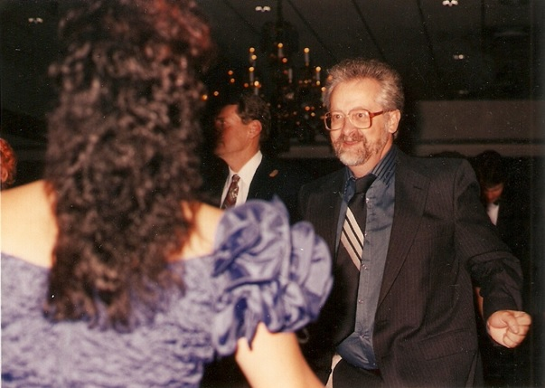
I DIDN’T KNOW JACK COULD DANCE
NEW OUT-LAWS TO ANN

Slide 28
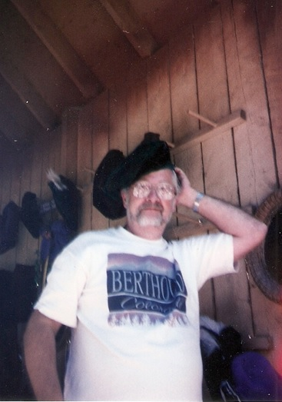
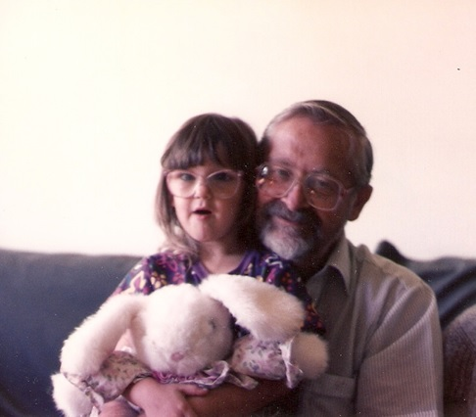
PROUD GRANDPA – PAPA JACK
GETTING READY FOR THE FASHION SHOW

Slide 29
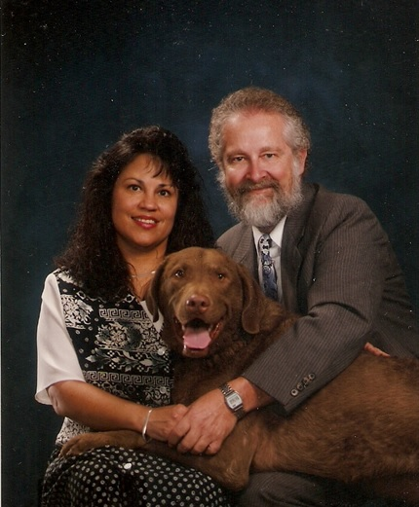
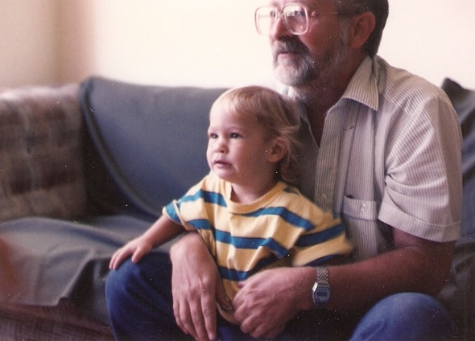
YES GINO – CHEER FOR THE REDSKINS
MIGHT AS WELL GET A DOG
ALL THE KIDS ARE GONE

Slide 30
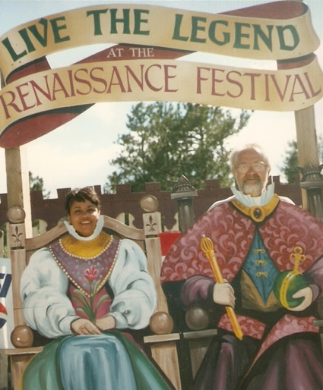
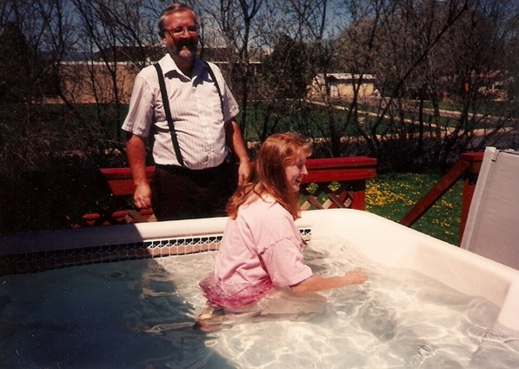
WELCOME NEW CREATION IN CHRIST
KING AND QUEEN DAWDY

Slide 31
WHAT WILL WE DO WITH ALL THESE TOYS?
NO DANTE. YOU CAN’T PLAY WITH GINO’S TOYS

Slide 32
NEW CHURCH – BERTHOUD MINISTRY CENTER
WOULD YOU MARRY THIS MAN AGAIN?

Slide 33
REALLY ANDREW, THE REDSKINS ARE THE BEST
FOUR SQUARE FUN

Slide 34
WE SURVIVED Y2K
2000’s AND BEYOND
WHAT A HANDSOME BUNCH

Slide 35
YEAH! DAVID’S MARRIED
YOU BOTH DON’T LOOK A DAY OVER…..

Slide 36
SEE JACK. ANDREW LIKES THE BRONCO’S
WE KNOW YOU ALWAYS WANTED TO BE A COWBOY

Slide 37
DON’T GET RID OF THE RV
JUST HANGING OUT

Slide 38
REALLY JACK – YOU NEED A TRIM
WHAT DO YOU GUYS THINK?

Slide 39
FIELD TRIP TO BRANSON
FORGET THE REDSKINS
WHAT A BUNCH OF CLOWNS

Slide 40
A LOVE THAT LASTS A LIFETIME

Slide 41
PUT IN A GOOD WORD FOR US

Slide 42
2 Timothy 4:7
I have fought the
good fight
I have finished the
race
I have kept the faith

